Slide 1

“Investigating the Parallels between using a RAT-Style Software for Malicious purposes and virtuous intent”
By Daniel Broomhead
27016005

Slide 2

What is a Rat?
Remote Administration Tool:
Virtuous
Productive
Benevolent
Benignant
Remote Access Trojan:
Promiscuous
Malicious
Deceitful
Surreptitious
At The Heart of it, they are the same ideology and technology.

Slide 3
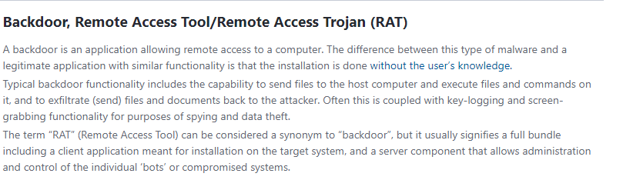
https://www.virusradar.com/en/glossary/backdoor

Slide 4
How are RATs used?
Remote Desktops
Administration
Computers
Remote access software
Usually part of a bigger system
Delivering a payload

Slide 5

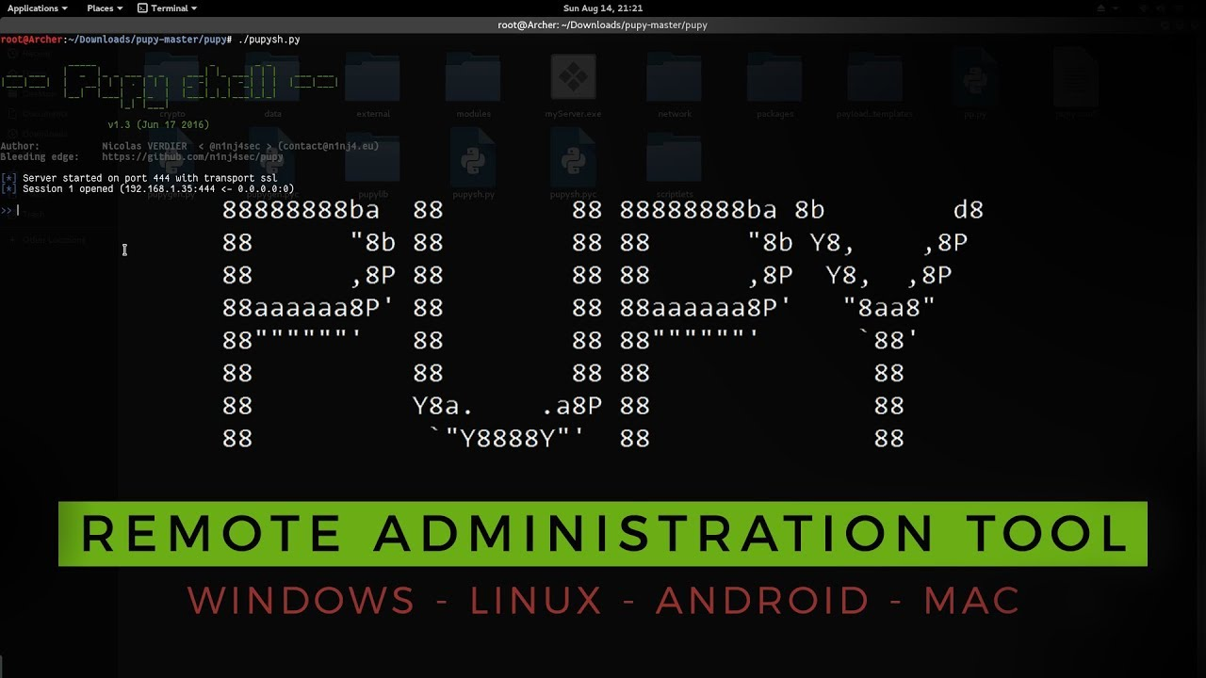

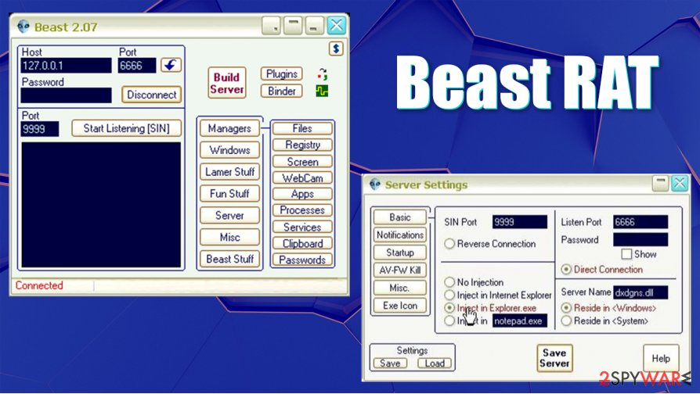
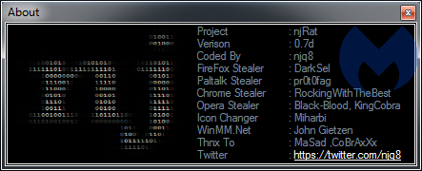
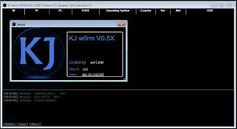
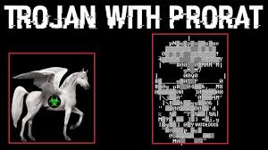

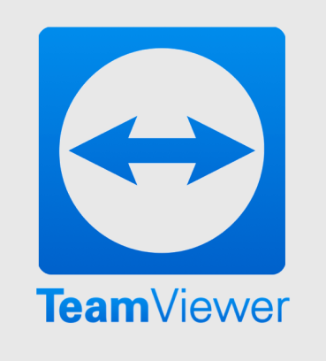
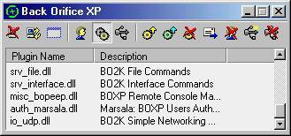
Examples:
Notes:
Beast = Delphi
PuPy – Crossplatform Python
NJ/ KJ JRAT - Java

Slide 6
General Considerations for Rats:
Language:
Methodology:
System:

Slide 7
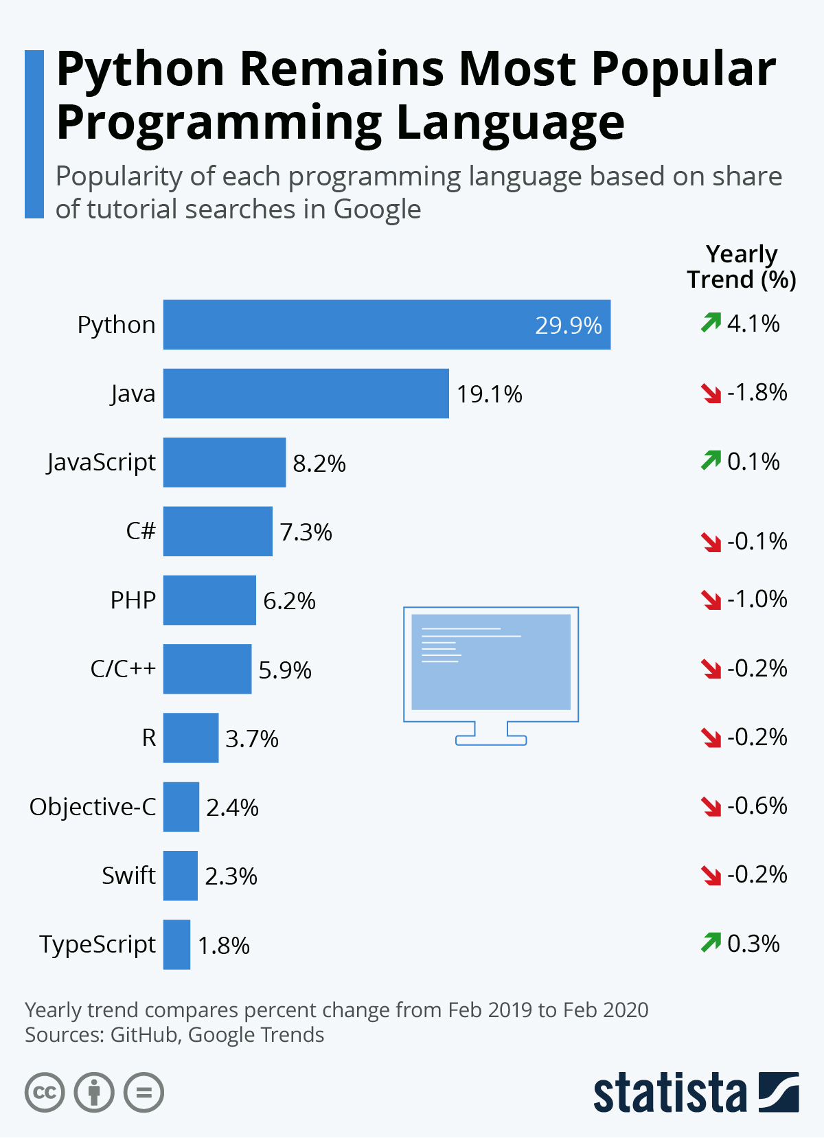
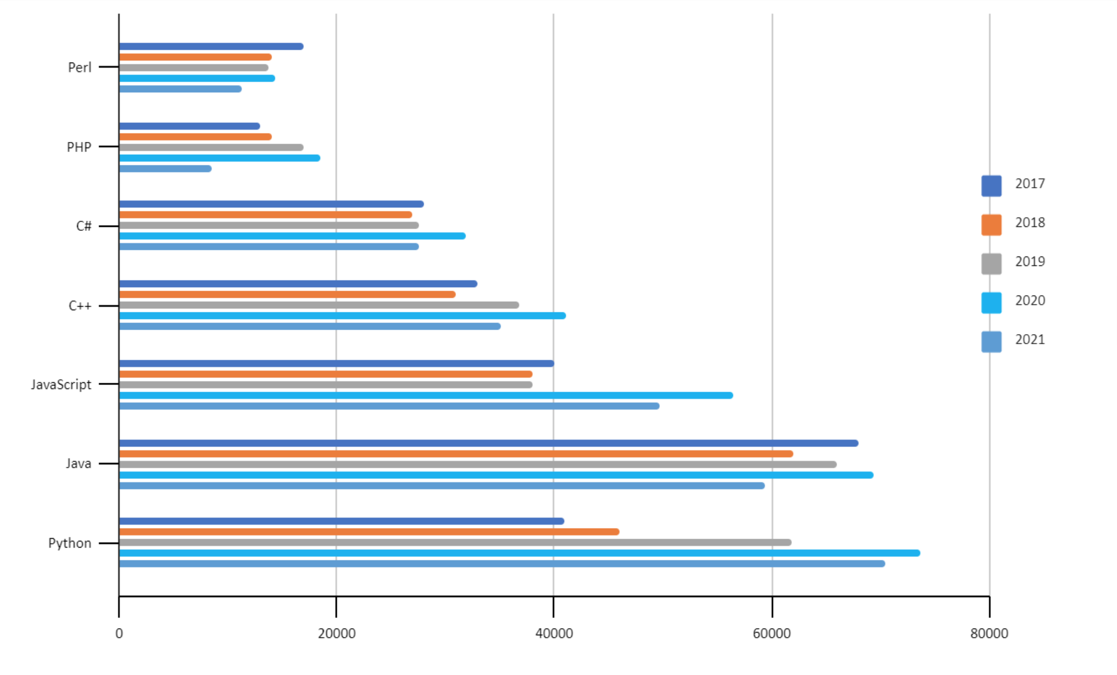
Python 3:
Python 2 is now deprecated.
Cross-Compatibility :Compatible with all major Platforms and Systems
Robust Standard Library
Depth of open-source frameworks, Extended libraries, community support
Effective in the IoT sphere
Tried & Tested Scalability
Python is a desired Language in the workplace – so this will be a good project to demo
Gaining popularity faster than ever
Fairly confident in this language but looking to develop skills further

Slide 8
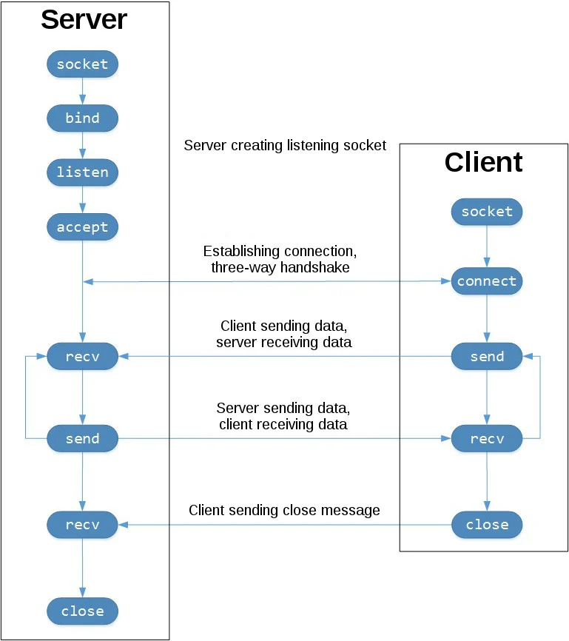
My Rat: The Crucial Decisions
Using the Python Socket module as an interface to the Berkeley Sockets API
TCP Sockets
Reliable: Dropper Packets retransmitted – no data lost
In-order: Data is read in the order it was written
UDP Does not share there properties and thus would not be appropriate.
This has been developed on Windows 10
Mainly for use on Windows 10

Slide 9
Current Functionality:
self.Switcher = { "-msgbox": self.systemmsg, "-msg": self.sendMsg, "-shutdown": self.shutdown, "-shutdownM": self.shutdownmessage, "-lock": self.locksystem, "-restart": self.restartsystem, "-EpIV": self.playstarwars, "-chess": self.playchess, "-weather": self.weather, "-telnet": self.enableTN, "-KLstart": self.startKeyLogger, #"-KLend": self.stopKeyLogger, "-getLogs": self.getKeyLogs "-getcb": self.getClipBoard, "-Fsend": self.filesend, "-Frecv": self.filereceive, "-ginfo": self.getTargetInfo, "-exe": self.exePy, "-ss": self.screenshot, "-vid": self.vidByFrames, "-shell": self.cmdctrl, "-email": self.email, "-dailymail": self.startEmailthread, "-endmailer": self.stopEmailThread }
Design Methodology offers easy expansion and advancements.
Send a console message
Send a custom messagebox Alert
Remote Shutdown (+ Remote Shutdown with custom message)
Remote Lock Device
Remote Restart
Play Starwars Via Telnet Connection
Play Chess Via Telnet Connection
Check the Weather Via Telnet Connection
Enable Telnet Client
Start Keylogger → Stop Keylogger
Retrieve Keylogs
Retrieve Clipboard Contents
Send a File
Retrieve a File / Folder
Obtain information about the target system
Execute a file
Screenshot
Series of screenshots → Video
Reverse shell
Send an email
Auto emailer – start /stop

Slide 10
What needs to be discussed:
The problem being solved.
The method used.
Results obtained so far.
Introduction, methodology, implementation, results
Background, Objectives, Algorithm, Scalability, applications

Slide 11
Future Functionality & Ideas:
Graphical user interface : either fully interactive or a graphical design made in console using ASCII art.
More effort into aesthetics
Time out feature: Session terminates after extended period.
More emphasis placed on the Virtuous style software
More research into RDP
Other Desktop Protocols
More support for other operating systems
EVEN MORE FUNCTIONALITY

Slide 12


Who am i?
Daniel Broomhead
27016005
R. U. Hacking? Society President
BCS Berkshire Student Chapter President
BCS Berkshire Early Careers Advocate
BCS Open Source Specialist Group – Young Representative
On track for BSc(Hons) Computer Science – First Class

Slide 13

Glossary & Terms:
RAT : Remote Access Trojan / Remote Administration Tool
TCP : Transmission Control Protocol
UDP : User Datagram Protocol
OOP : Object Oriented Programming
OOD : Object Oriented Design
FTP : File Transfer Protocol
UI : User Interface
GUI : Graphical User Interface
RDP : Remote Desktop Protocol

Slide 14
Presentation Checklist:
Approx 10 slides: MAX 10 MINS
Project & Project Process
Demonstration of application / program

Slide 15
Structure & Content Quality
Presentation structure
Content order
Content balance
Content distribution
Planning
Problem definition / objectives
Results
Conclusions
Length
Citations
Process
Self reflection

Slide 16
Technical content
Clear scope
Purpose of the application / program
Logical navigation
Clarity of explanation
Innovative functions and features

Slide 17
Functionality & performance
Results correctness toward the intended purpose
Appropriate UI
Visualisation
Algorithms
Reliability
Completeness

Slide 18
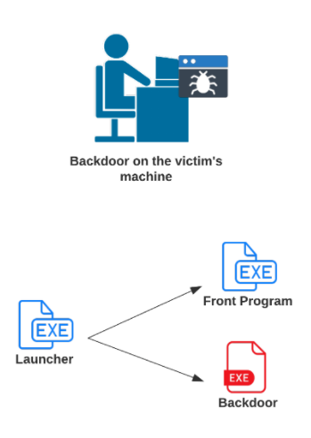
The generated executables
PyInstaller used to generate a packaged executable
Executable then taken from maze game
Create a script which launches the front program(Maze) and a threaded daemon for the client side of the RAT
Create an executable from this script.
All 3 executables needed on client device.
Need to be in designated file paths specified in launcher.py

